Slide 1

A Presentation on “COLLEGE PLACEMENT PORTAL” By Vivek Jain Mahaveer Mandloi Vishwa Bhalodia Under the Guidance of Prof. Suraj Patil
(70552100059) (70552100091) (70552200005)
Department of Computer Science
MPSTME, Shirpur Campus
2023-24

Slide 2



Slide 3

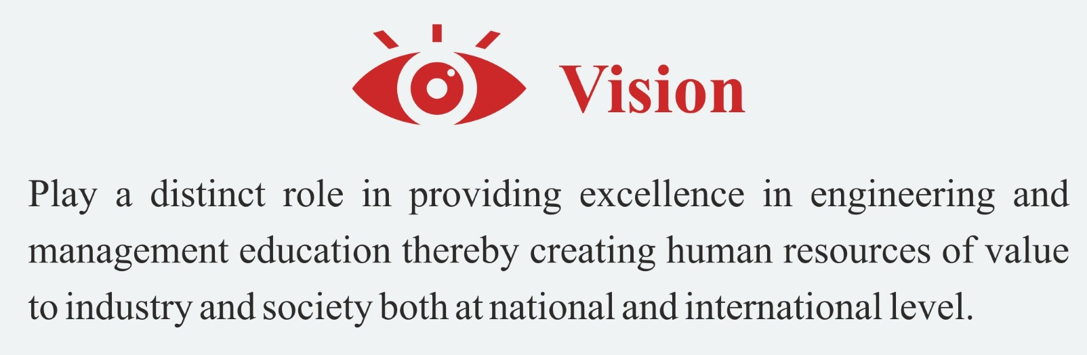

MUKESH PATEL SCHOOL OF TECHNOLOGY
MANAGEMENT & ENGINEERING
Shirpur Campus
MUKESH PATEL SCHOOL OF TECHNOLOGY MANAGEMENT & ENGINEERING, SHIRPUR CAMPUS

Slide 4

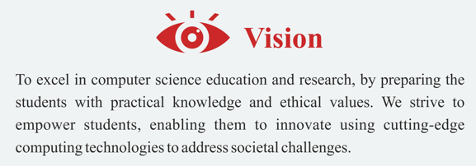
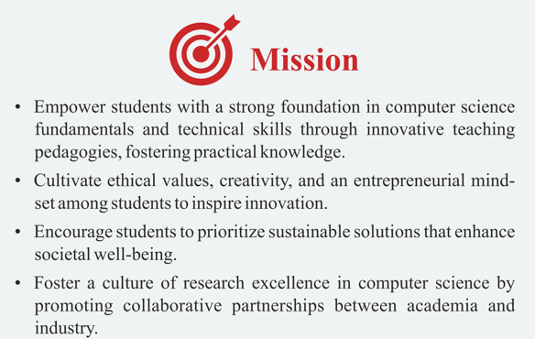
MUKESH PATEL SCHOOL OF TECHNOLOGY
MANAGEMENT & ENGINEERING
Shirpur Campus

Slide 5
Outline
Objective of Project
Literature Survey
Problem Statement
Proposed Solution
Software and Hardware Requirements
Project Development Timeline (Gantt Chart)
References

Slide 6
Objective of Project
Develop a college placement portal to enhance and streamline the campus recruitment process, making it efficient, transparent, and user-friendly for students, recruiters, and college administrators. The objective is to manage all data records systematically, ensuring they are instantly accessible without extra effort and free from redundancy.

Slide 7
Problem Statement
The traditional campus placement process is often manual, time-consuming, and inefficient, leading to communication gaps . It lacks real-time communication and is cumbersome to manage manually. There is a need for a centralized, digital solution to facilitate easier access to placement opportunities and streamline the application process.

Slide 8
Literature Survey
Sr No. | Authors | Technologies Used | Drawbacks
1 | Sahil Ganeshkar, et al., 2023 [1]. | Frontend: HTML, CSS, JavaScript Backend: PHP Database: MySQL | Reliance on manual data entry, limited notification methods, lack of industry interaction features, and insufficient data security measures. Additionally, implementing comprehensive analytics and ensuring system scalability are crucial for better performance and user satisfaction.
2 | Mrs. B.Sathyabama, et al., 2019 [2]. | Programming and application development: Java Database connectivity: JDBC Mobile application development​: Android | The placement system can be improved by enhancing the user interface, strengthening security with encryption and authentication, automating repetitive tasks, and optimizing for scalability to handle more users and data efficiently.

Slide 9
Literature Survey
Sr No. | Authors | Technologies Used | Drawbacks
3 | Fiza Kousar, et al., 2022 [3]. | MERN Stack using: Database: MongoDB Server-side framework: Express.js Frontend: React.js Server-side runtime environment: Node.js | The app's drawbacks include limited scalability, a need for a more intuitive user interface, and insufficient real-time notifications. Additionally, advanced data analytics for insights into placement trends are lacking, and the current system may struggle to handle a large volume of simultaneous users efficiently.
4 | Shital K. Patil, et al., 2022 [4]. | Backend: Python- Web framework: Django Frontend: HTML, CSS, Javascript Database: MYSQL | The demerits are limited customization for job filtering, potential inefficiencies and errors in manual data handling, and possible scalability issues affecting performance as user numbers and data volume increase. Enhanced features and better data management practices could address these concerns.

Slide 10
Literature Survey
Sr No. | Authors | Technologies Used | Drawbacks
5 | Prof. Bharat Dhak, et al., 2022 [5]. | Salesforce: A cloud-based CRM platform. Visualforce: A component-based user interface framework part of Salesforce force.com used for creating dynamic interfaces. | The research gaps include dependency on internet connectivity for accessing data, potential complexities in managing and customizing the platform for specific institutional needs, and possible challenges in ensuring data privacy and security for sensitive student information.
6 | Abhay Padavi, et al., 2023 [6]. | Python, Java, Android, .NET, and Firebase | The portal lacks dependence on consistent internet access, potential security vulnerabilities, the need for regular updates and maintenance, and the initial cost and time required for development and implementation. risk of data breaches, and the potential for technical issues or downtime.

Slide 11
Literature Survey
Sr No. | Authors | Technologies Used | Drawbacks
7 | Shivani Chaurasia, 2023 [7]. | Python, Django web framework, HTML, CSS, and JavaScript, MySQL | Limited user interface flexibility, which may hinder user experience. The need for continuous updates to keep up with changing technologies and requirements. Potential data security issues due to reliance on centralized databases.
8 | Mr. Puneshkumar U. Tembhare, et al., 2022 [8]. | Android Studio: For app development. Internet-based platform Security and authentication features Excel sheets | The drawbacks are it is cost-inefficient, lacks accuracy, is hard to manage, and does not offer adequate security. These limitations hinder the effectiveness and reliability of the system, making it challenging for users to maintain and protect the data efficiently.

Slide 12
Literature Survey
Sr No. | Authors | Technologies Used | Drawbacks
9 | Ashish Nanotkar, et al., 2023 [9]. | OS: Windows 10 IDE: Visual Studio Languages and Frameworks: Next.js, Tailwind CSS, Node.js, TypeScript Database: MySQL, Prisma, Blob Designing Tool: Draw.io | The drawbacks include potential data entry errors despite attempts to minimize them, a lack of formal training requirements which might lead to misuse, and the need for continual updates and maintenance to ensure reliability and security.
10 | Twinkle Panchal, et al., 2022 [10] | Frontend: HTML, CSS, JavaScript Backend: PHP, MySQL Mobile Access: Android Servers: Database server, Web server | The system faces connectivity issues during development, limited scope of automation, reliance on manual input, and lack of advanced features like data analytics for placement trends and predictive insights. Additionally, maintaining up-to-date and accurate student and company data can be challenging.

Slide 13
Proposed Solution
1. Centralized Data Management
- A unified platform to store and manage student profiles, job postings, and company details, accessible via a web interface.
2. Real-Time Notifications and Communication
- Integrated messaging system and real-time notifications to ensure prompt communication between students, recruiters, and administrators.
3. Streamlined Application Process
- Online application submission and tracking, allowing students to apply for jobs and monitor their application status easily.
4. Web Accessibility
- Responsive design for seamless access across various devices, including desktops, laptops, tablets, and smartphones.
5. Data Analytics and Reporting
- Built-in analytics tools to provide insights on placement trends, student performance, and company engagement.
6. Enhanced Security
- Secure login system with multi-factor authentication and data encryption to ensure the confidentiality and integrity of user data.

Slide 14
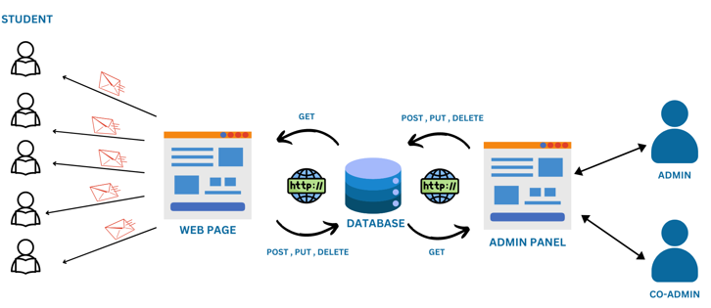
Proposed Solution

Slide 15
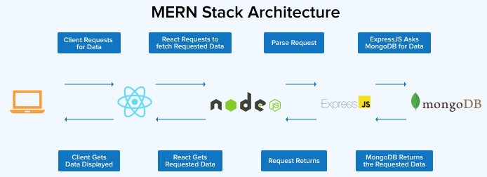
Software Requirements
Software:
Frontend: React.js for mobile compatibility.
Backend: Node.js with Express.js.
Database: MongoDB for scalable and flexible data storage.
Authentication: JSON Web Tokens for secure user authentication.

Slide 16
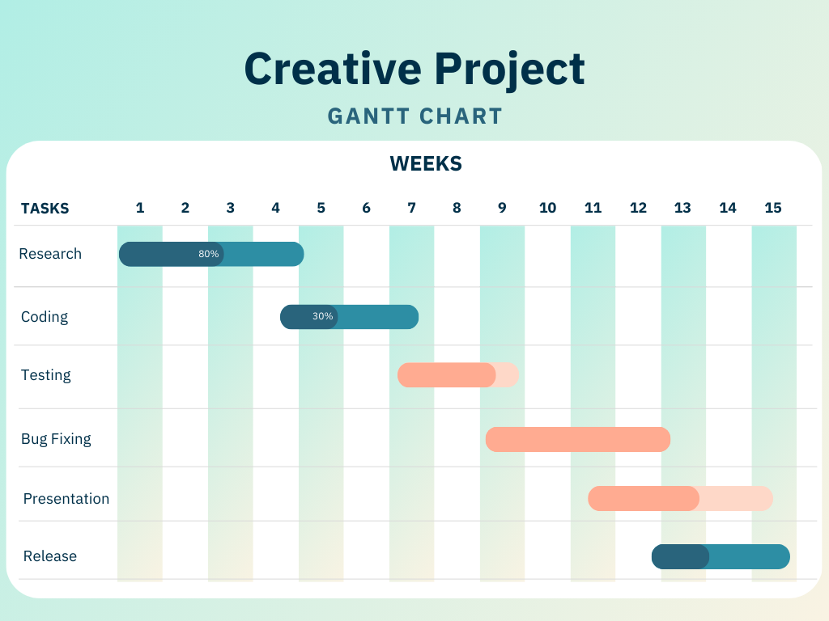
Project Development Timeline

Slide 17
References
Sahil Ganeshkar, Sagar Khadilkar, Shubhangi Gahukar, Achal Punyapreddiwar, Kanak Thool, Prof. Sandeep Ganorkar (2023). Web App for College Campus Placement System. International Research Journal of Modernization in Engineering Technology and Science, Volume:05/Issue:04/April-2023. https://www.doi.org/10.56726/IRJMETS35961
Mrs. B.Sathyabama, Mr. S. Mohamed Salahudeen, Mr. Z. Mohamed Sohail, Mr. P.S. Mohamed Asarutheen4 (2019). App Development for Placement Drive and Recruitment Process. International Journal of Computer Science and Mobile Computing, Vol.8 Issue.10, October- 2019. https://www.academia.edu/40600340/APP_DEVELOPMENT_FOR_PLACEMENT_DRIVE_AND_RECRUITMENT_PROCESS_
Fiza Kousar, Gandharva V Hegde, Prof. Saravanan C (2022). Design and Development of Department Placement Portal using MERN Technology. International Advanced Research Journal in Science, Engineering and Technology, Vol. 9, Issue 1, January 2022. https://iarjset.com/wp-content/uploads/2022/02/IARJSET.2022.9164.pdf
Shital K. Patil, Sakshi S. Thombare, Rasika R. Wadhonkar, Sonal R. Wankhade (2022). Web Portal for Training and Placement Cell. International Journal of Advanced Research in Science, Communication and Technology (IJARSCT), Volume 2, Issue 1, May 2022. https://ijarsct.co.in/Paper3593.pdf
Prof. Bharat Dhak, Himanshu Bhoyar, Yash Bangare, Gaurav Zade (2022). Training and Placement Application for College using Salesforce. International Research Journal of Modernization in Engineering Technology and Science, Volume:04/Issue:01/January-2022. https://www.irjmets.com/uploadedfiles/paper//issue_1_january_2022/18715/final/fin_irjmets1644260217.pdf

Slide 18
References
Abhay Padavi, Nikhil Birajdar, Rahul Raut, Suzanne Shaikh, Pratima Patil (2023). Development of a Web Portal for the Training and Placement Cell of the College. International Journal for Research in Applied Science & Engineering Technology (IJRASET), Volume 11 Issue V May 2023. https://typeset.io/pdf/development-of-a-web-portal-for-the-training-and-placement-3kk7301i.pdf
Shivani Chaurasia (2023). Student Internship Placement Management System using Python. International Journal of Research in Science and Engineering, Vol: 03, No. 03, April-May 2023. https://doi.org/10.55529/ijrise.33.30.49
Mr. Puneshkumar U. Tembhare, Anand Khobragade, Rushabh Pachare, Sanjeev Sharma, Chaitanya Ramteke, Vaibhav Patil (2022). Training and Placement Cell Android Application. International Journal of Innovations in Engineering and Science, Vol. 7, No. 2, 2022, PP. 20-23. https://doi.org/10.46335/IJIES.2022.7.2.3
Ashish Nanotkar, Nikita Jamgade, Prayas Tiwari, Siddhesh Ninawe, Prayash Bhoyar, Rahul Yadav (2023). Development of Web Application to Automate Training & Placement Process. International Journal of Novel Research and Development, Volume 8, Issue 3 March 2023. https://www.ijnrd.org/papers/IJNRD2303426.pdf
Twinkle Panchal, Mayuresh Wadke, Prof. Aishwarya Sedamkar (2023). Placement Management System. International Research Journal of Engineering and Technology (IRJET), Volume: 09 Issue: 04 | Apr 2022. https://www.irjet.net/archives/V9/i4/IRJET-V9I4301.pdf

Slide 19
THANK YOU

